Slide 1



An Analysis of a Particle Size Frequency Distribution for a 6.4-gram Aggregate Sample of Asteroid Bennu
Savannah Smith
Mentor: Dr. Andrew Ryan, Lunar and Planetary Laboratory, The University of Arizona
Arizona NASA Space Grant Consortium Statewide Symposium, Arizona State University
19 April 2025

Slide 2
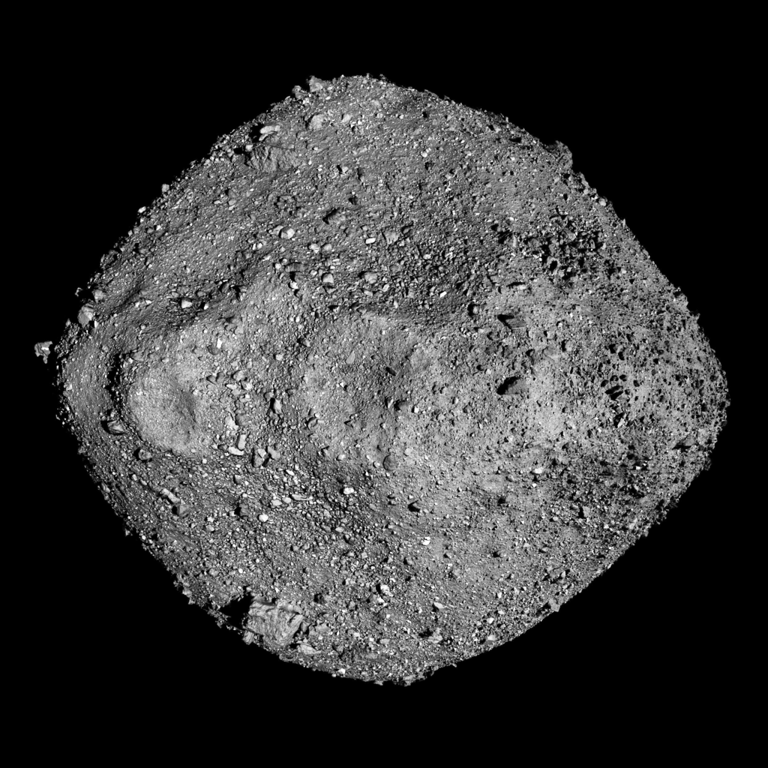
Asteroid (101955) Bennu
2
~ 500 m carbonaceous, near-Earth, rubble-pile asteroid
Likely broke off from a 100-200 km, carbon-rich parent body
Sample was collected October 2020 and returned September 2023
The goal of the OSIRIS-REx mission is to improve our understanding of our solar system’s formation and evolution
Image credits: NASA Goddard Space Center and The University of Arizona

Slide 3
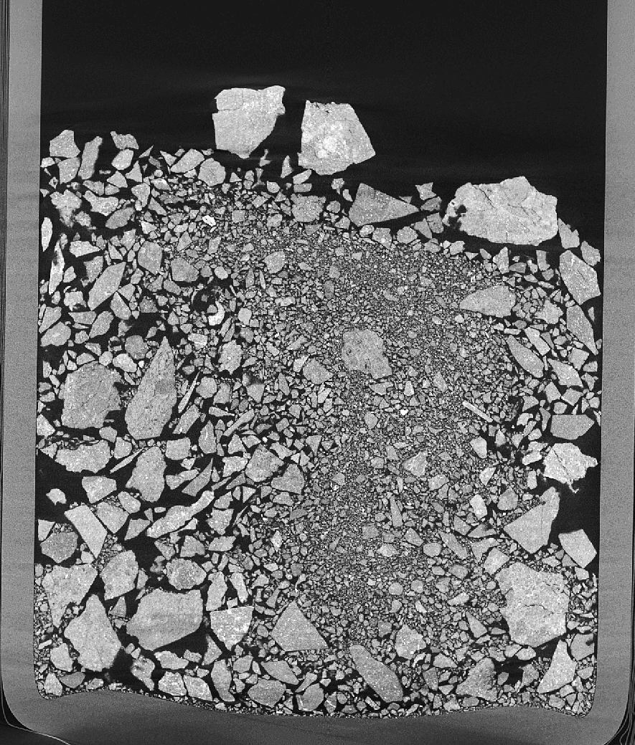
Overview of OREX-800107-0
3
X-ray Computed Tomography (XCT) data
Slices in x, y, and z: 1389 x 1383 x 1719
Voxel size of 17 microns (0.017 mm)
Contains roughly 1.5 to 2 million grains
Size range: less than 0.017 mm (unresolvable material) to approximately 6 mm
My goal was to determine the size of each grain and compose a particle size frequency distribution (PSFD) for this sample
Image credits: Dr. Scott Eckley, NASA Johnson Space Center

Slide 4
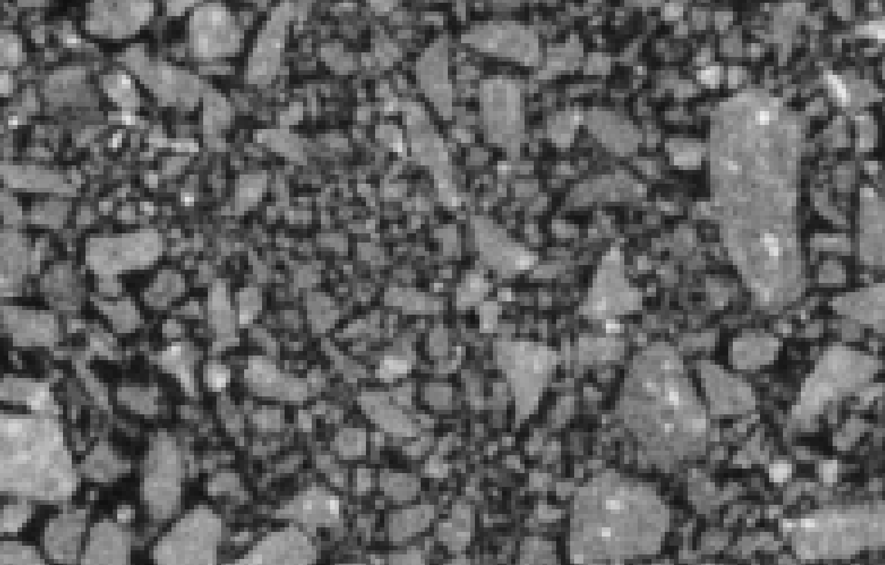
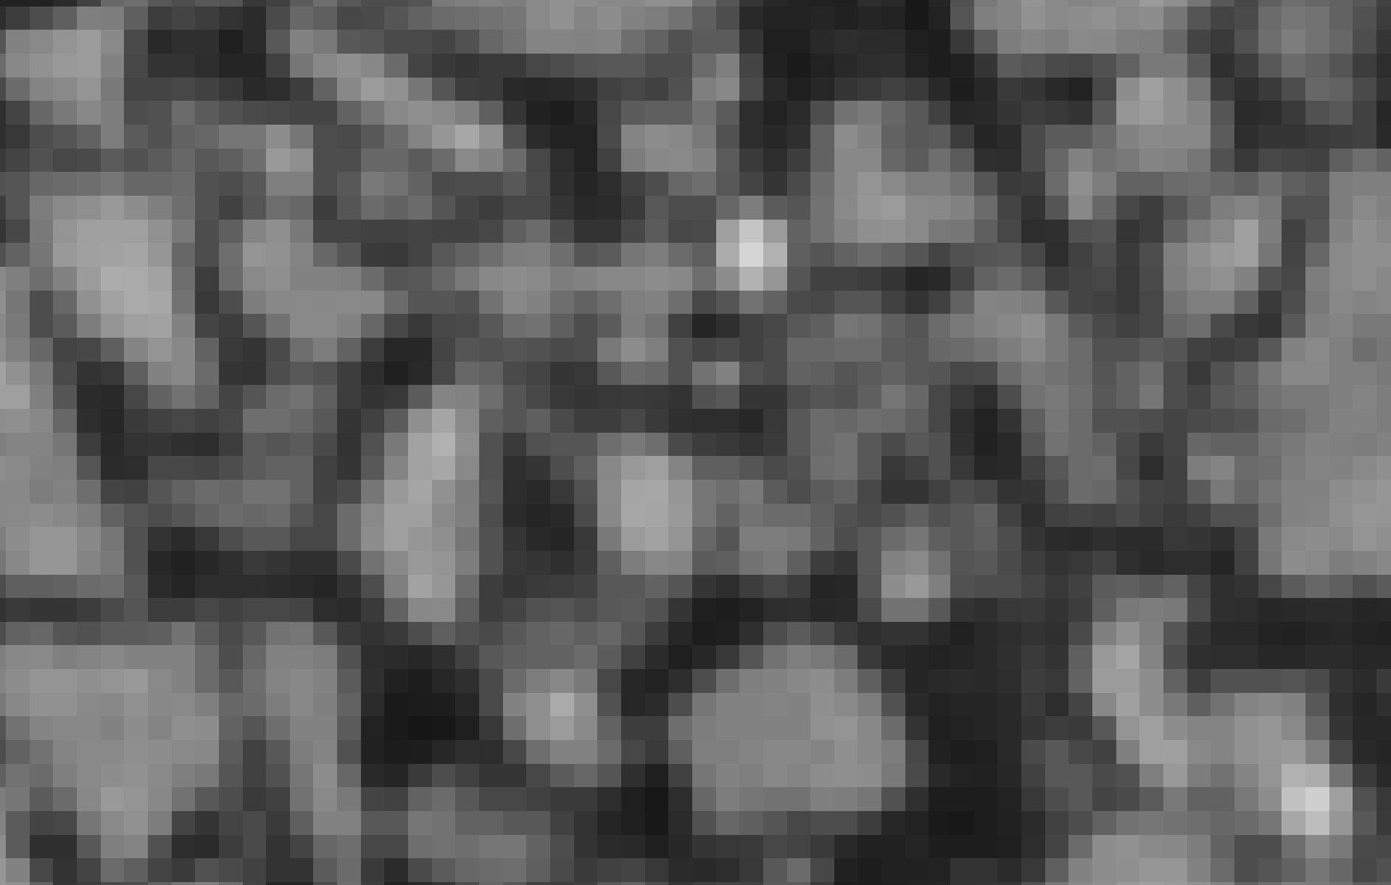
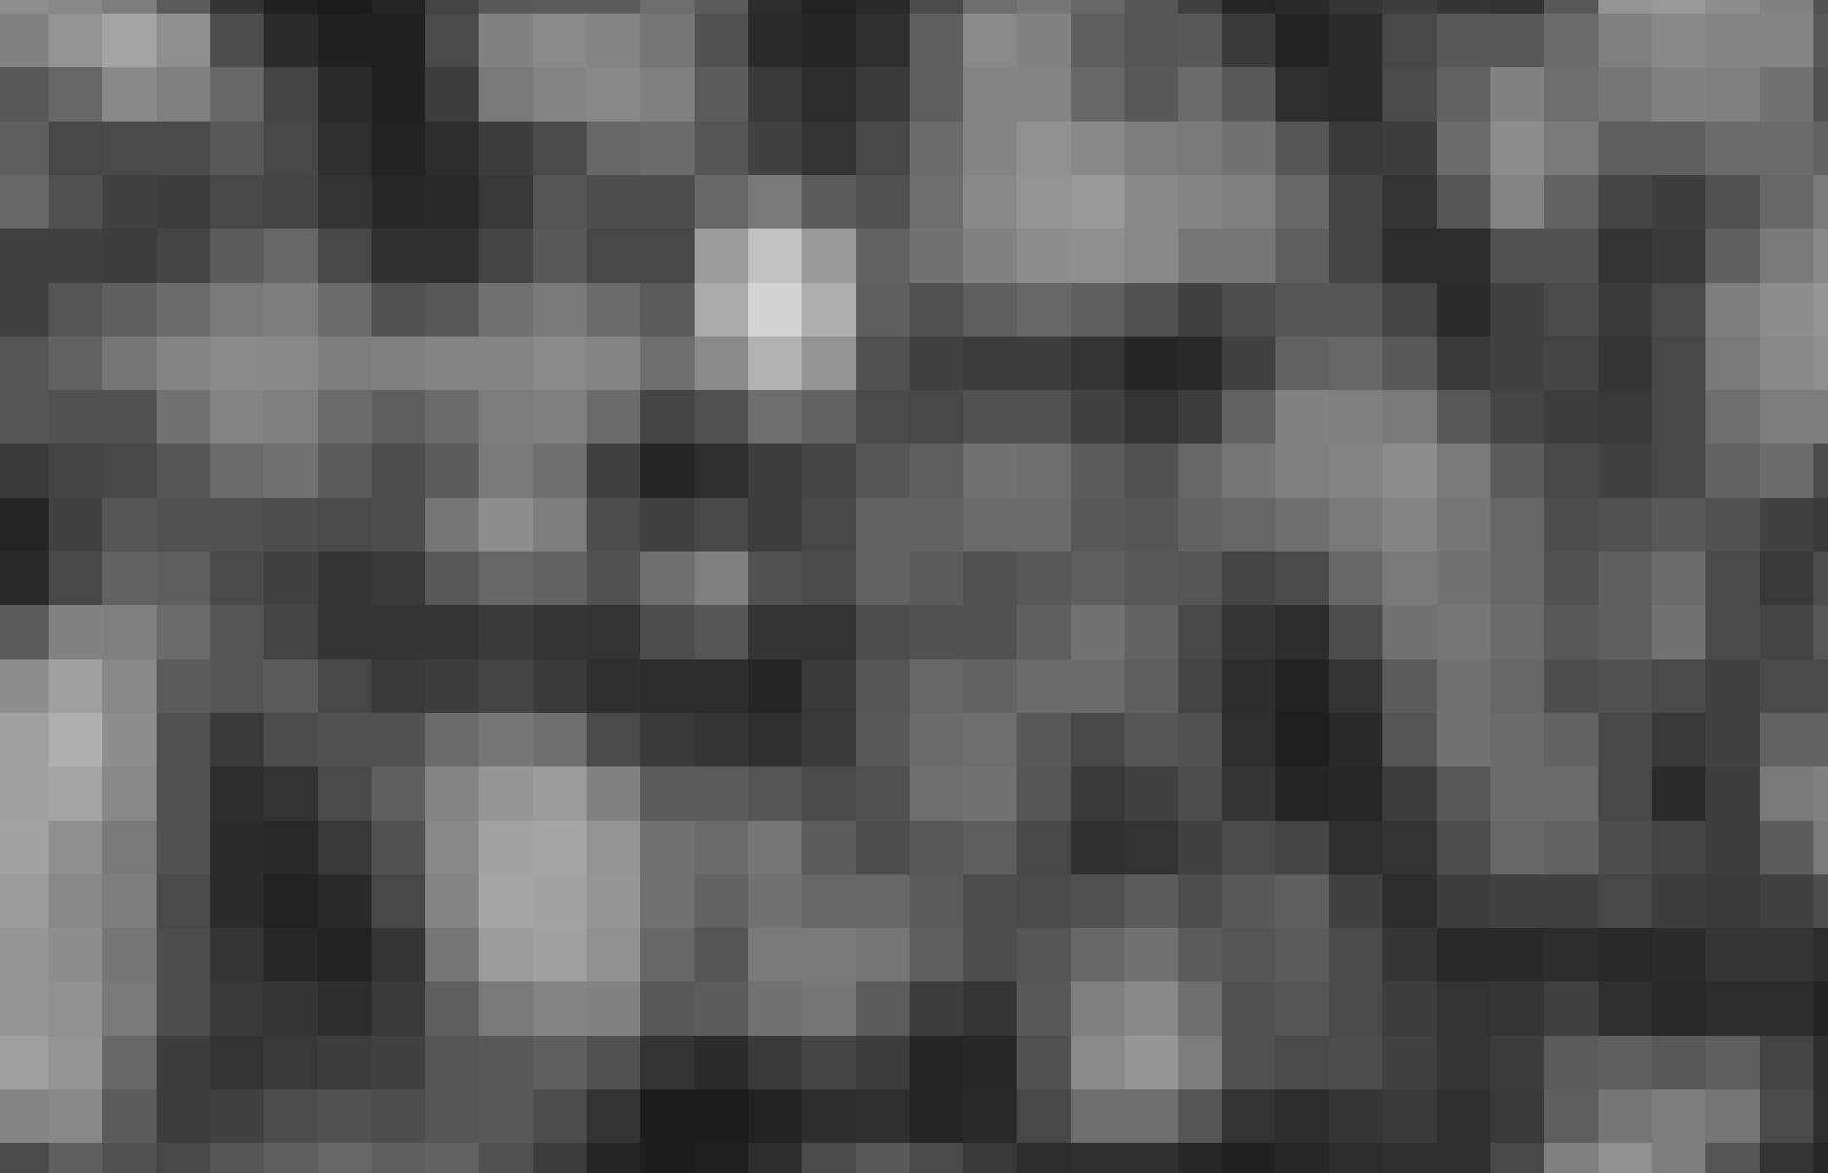
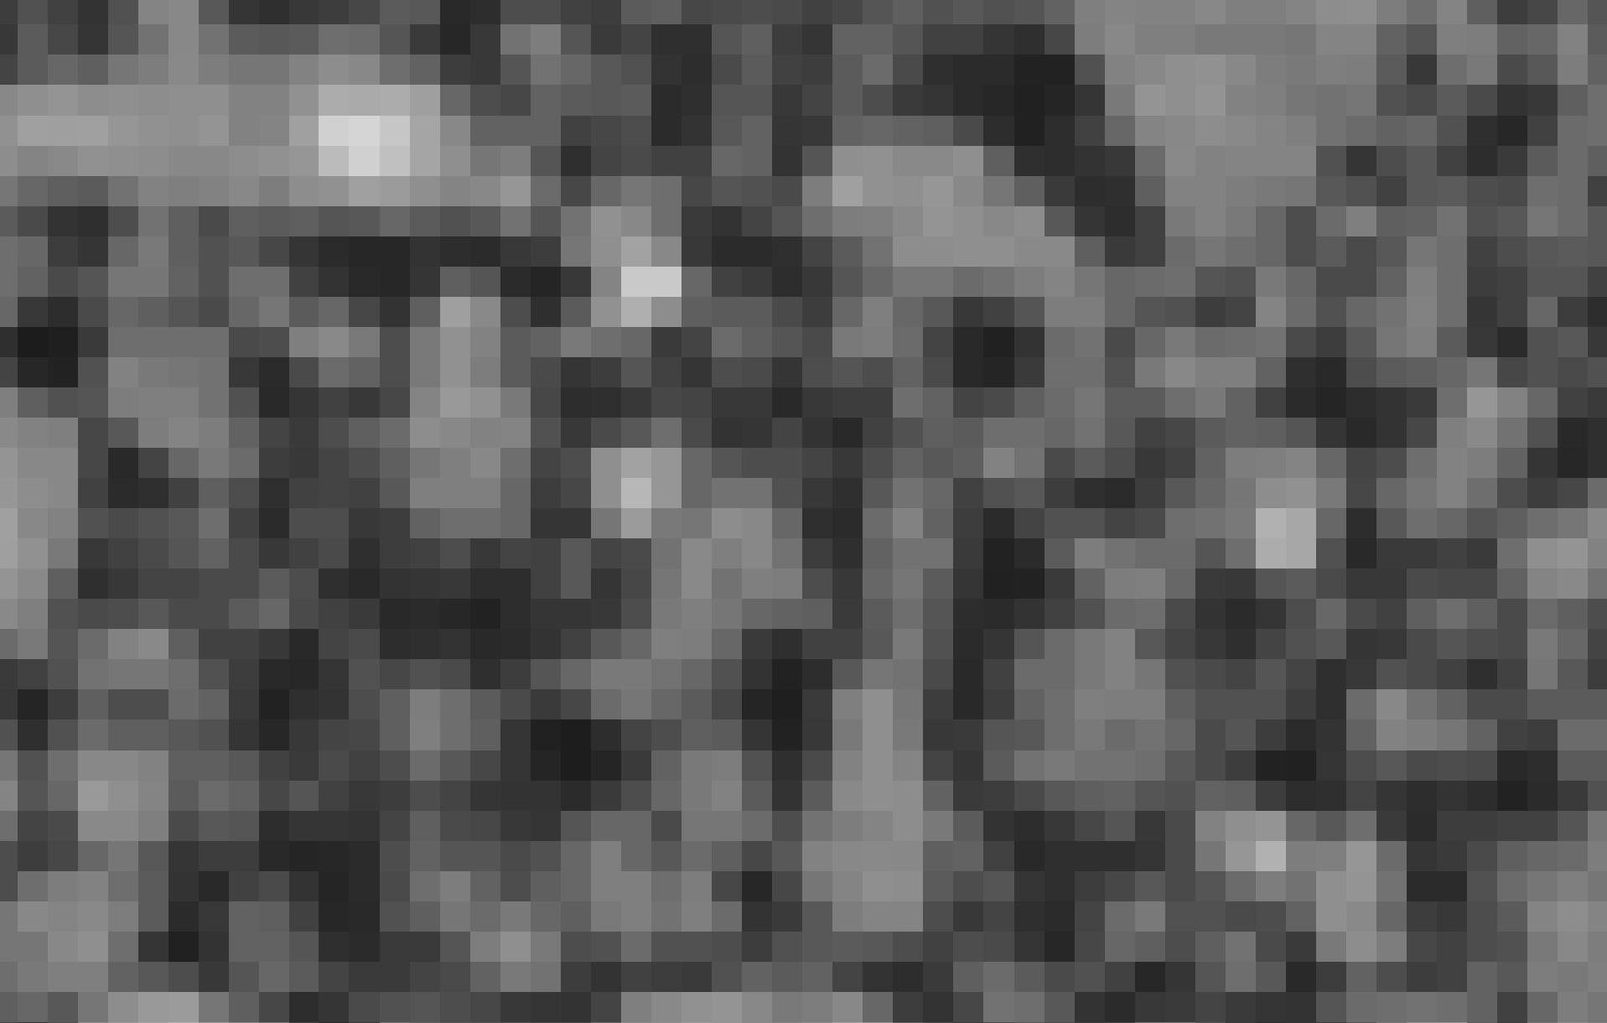
4
Examples of Unresolvable Material
Image credits: Dr. Scott Eckley, NASA Johnson Space Center

Slide 5
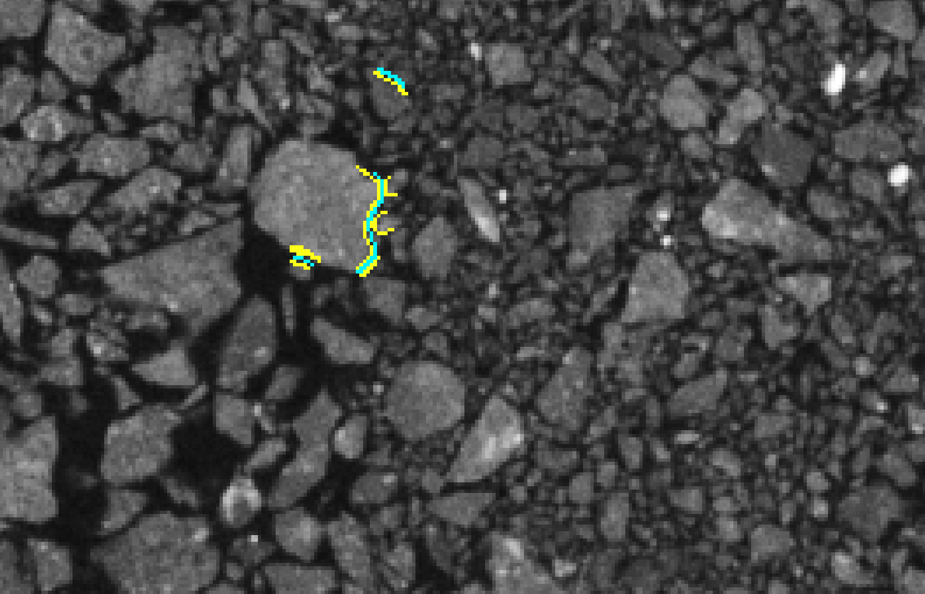
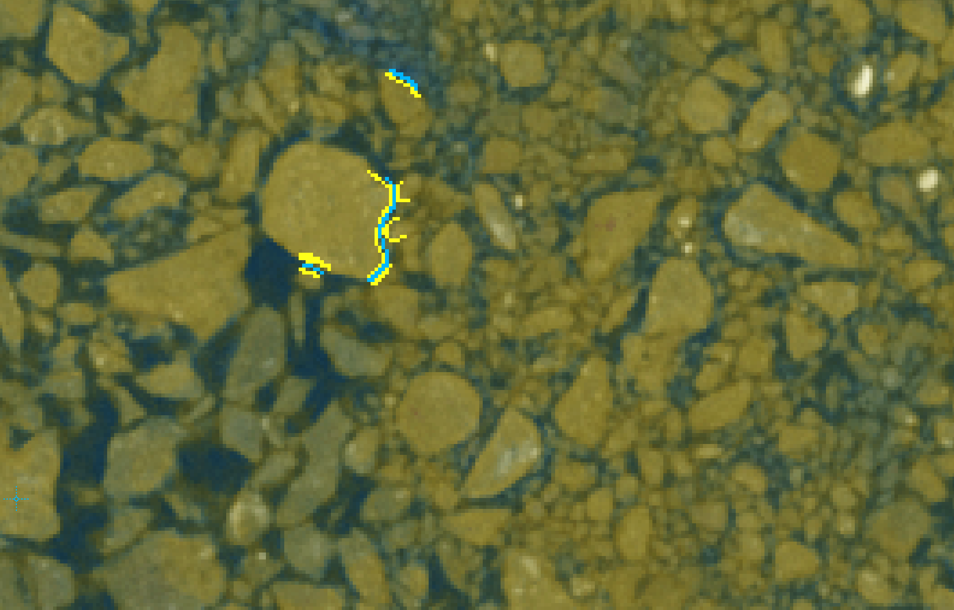
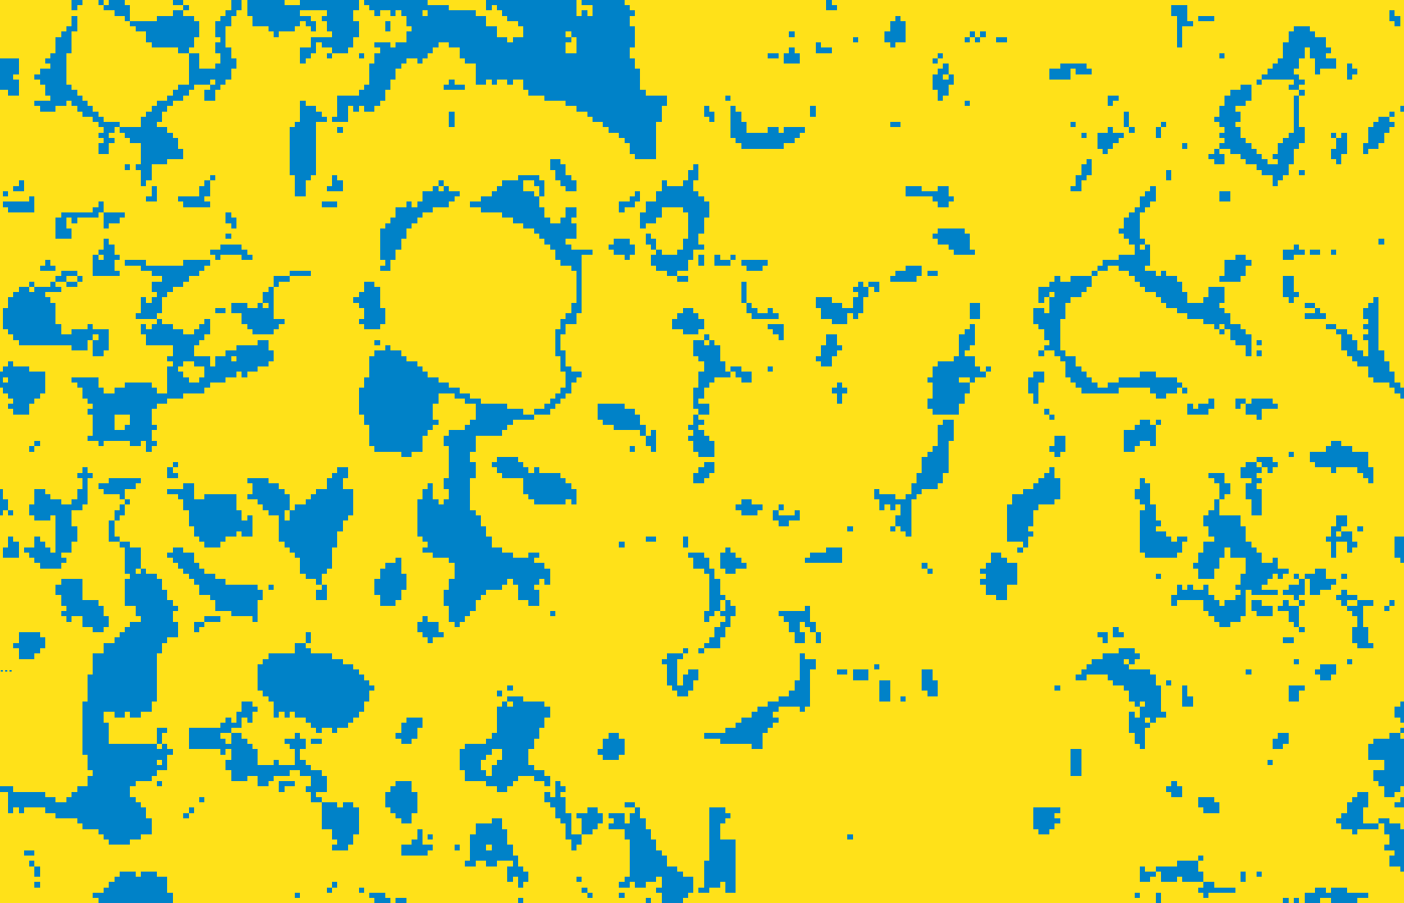
Problem with Unresolved Material
5
Image credits: Dr. Scott Eckley, NASA Johnson Space Center
(yellow and blue color from Ilastik software)

Slide 6
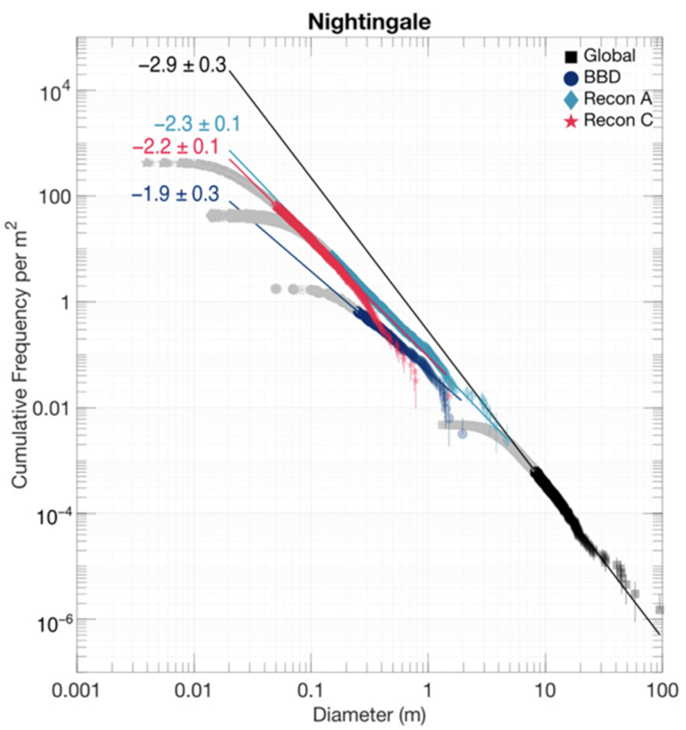
Current Understanding of Bennu
6
This PSFD is from different particle count datasets in Burke et al. 2021
Power-law slopes of this PSFD
Global: -2.9 +/- 0.3
Recon C: -2.2 +/- 0.1
Results from Italy (Pajola & Tusberti)
Power-law slope of -2.1 +/- 0.3 for particle size range of 1.1 mm to 36.6 mm
Image credits: Burke et al. 2021

Slide 7
Methods
7
Used image processing software Ilastik for grain segmentation to map distinct particles
The XCT data was input as a stack of TIFF images along the z-axis
Random Forest machine learning algorithm was trained on user annotations
Three classes used for segmentation: grain, vessel, matrix
Outputs from Ilastik were imported into custom Python script to determine the longest axis of each grain
These preliminary results were computed using a bounding box algorithm
The end goal is to compute the Euclidean pairwise distance between the farthest voxels of each grain
The PSFD was generated using matplotlib

Slide 8
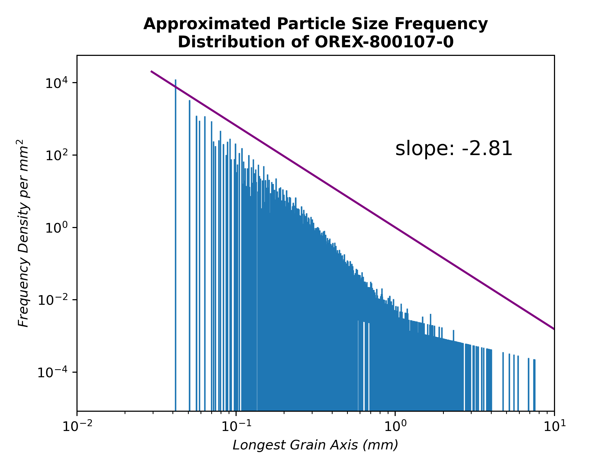
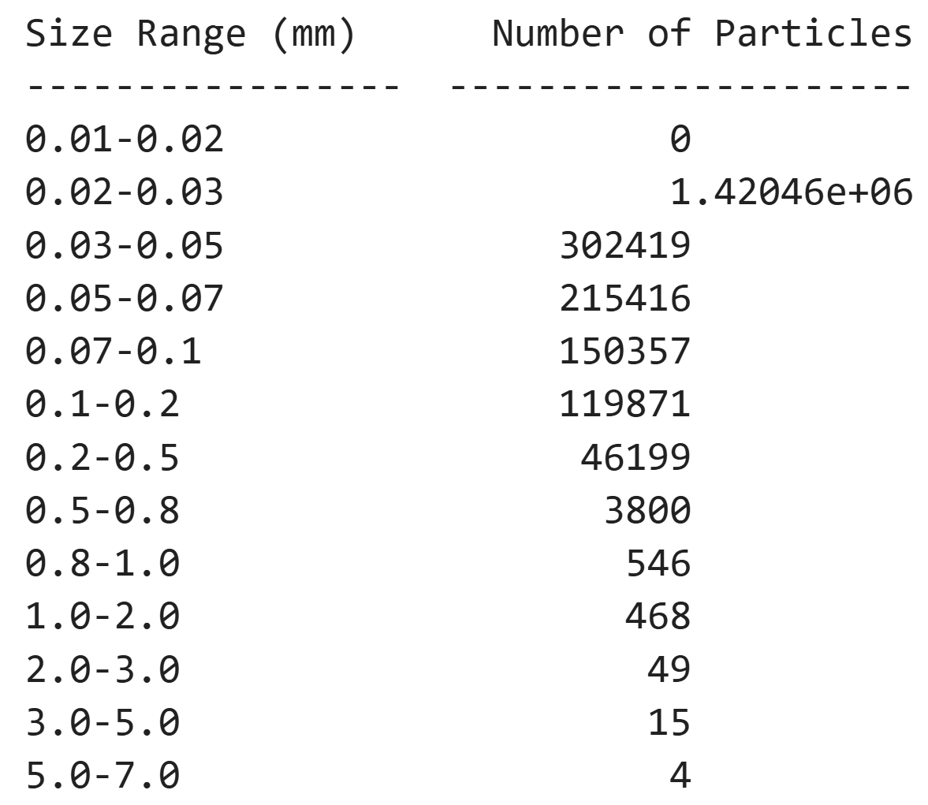
Particle Size Frequency Distribution
8

Slide 9
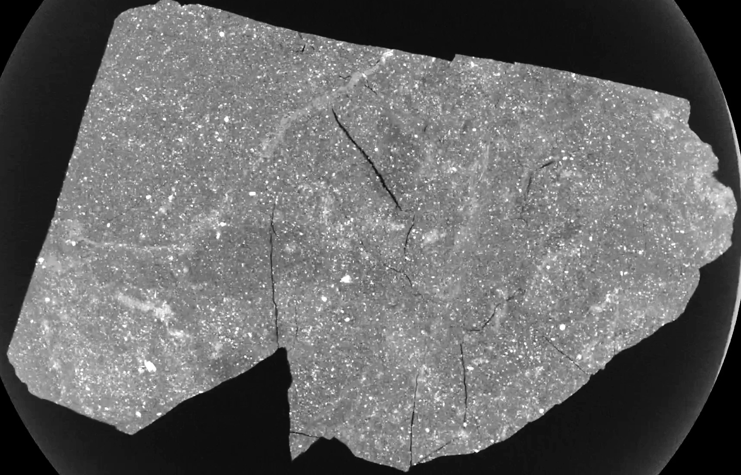
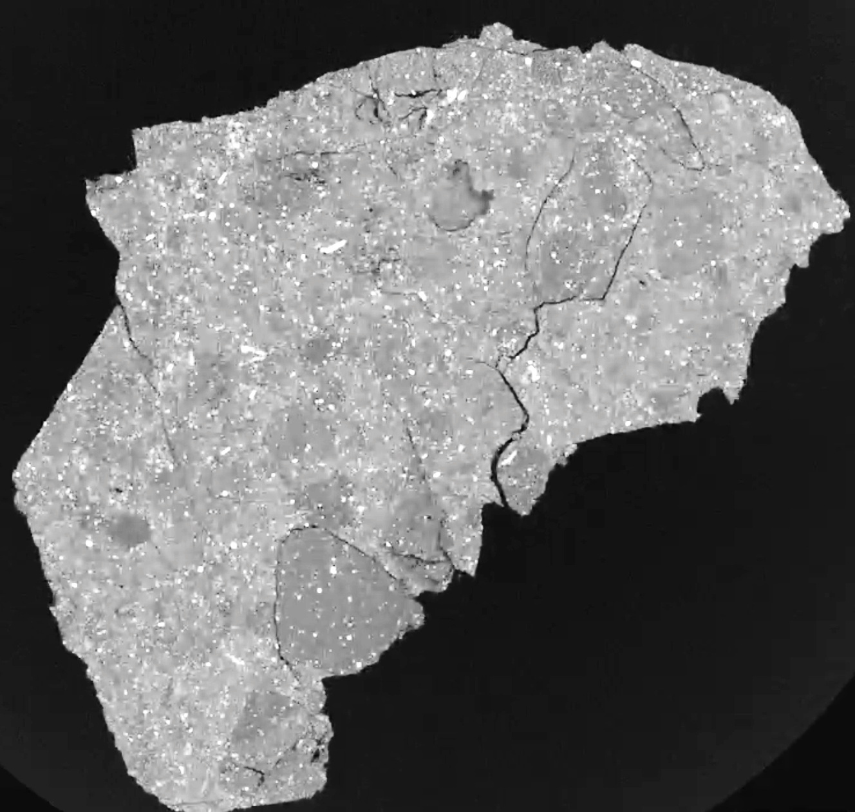
Future Work
9
Work towards more accurate results
Improve current Ilastik model and explore other grain segmentation strategies, including deep-learning neural networks in Dragonfly
Use bounding box algorithms to classify grains by their shape
Sphericity and roundness
Angular or hummocky?
Can result in two different PSFDs
Comparison to other rubble-pile asteroids
OREX-800145-0
OREX-800108-0
Image credits: Dr. Scott Eckley, NASA Johnson Space Center

Slide 10
Conclusion
10
Complex XCT data with large particle size range: [ > 0.017 mm, ~ 6 mm ]
Results in this presentation are a work in progress
My preliminary PSFD power-law slope is similar to the global measurement but is significantly steeper than the Recon C measurement
My preliminary slope: -2.81
Burke+2021 (global): -2.9 +/- 0.3
Burke+2021 (Recon C): -2.2 +/- 0.1
Bennu is not void of small particles
Small particles could affect the cohesive strength of rubble-pile asteroids

Slide 11
Acknowledgements
11
Dr. Andrew Ryan, Lunar and Planetary Laboratory, University of Arizona
Dr. Zack Gainsforth, Space Sciences Laboratory, University of California, Berkeley
Dora Elalaoui-Pinedo, University of Arizona
Michelle Coe and Dr. Chandra Holifield Collins, Arizona Space Grant Consortium
Arizona Space Grant Consortium
Lunar and Planetary Laboratory, University of Arizona

Slide 12
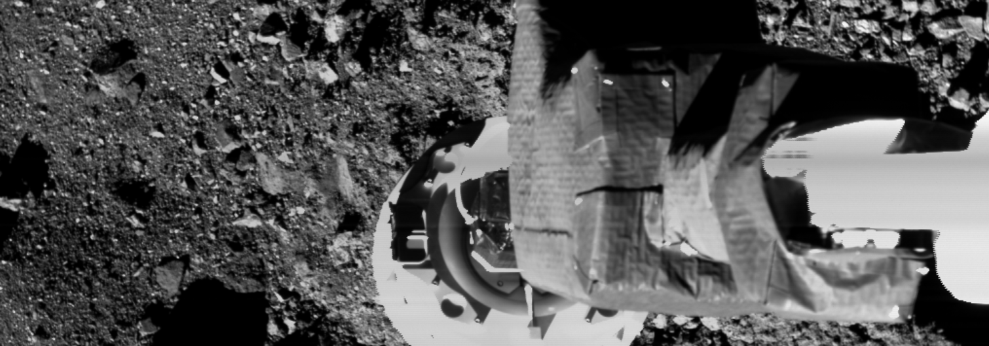
Thank you !
Image credits: NASA/Goddard/University of Arizona

Slide 13
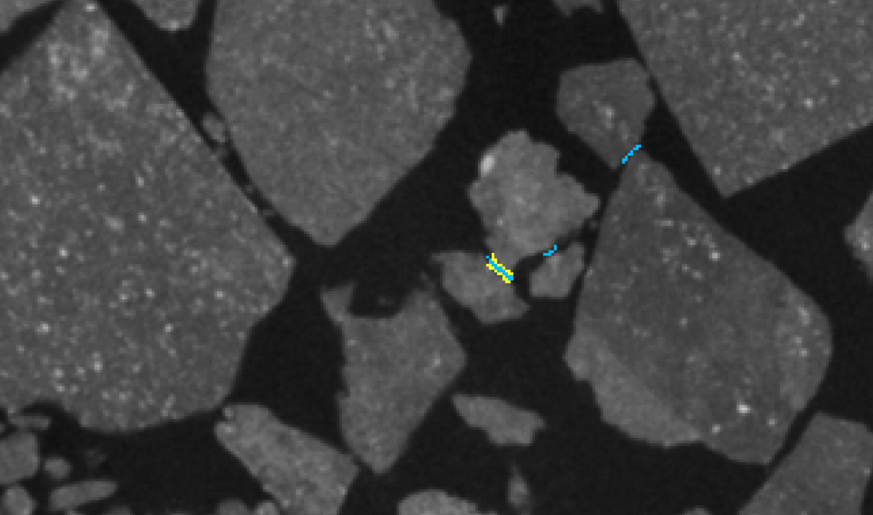
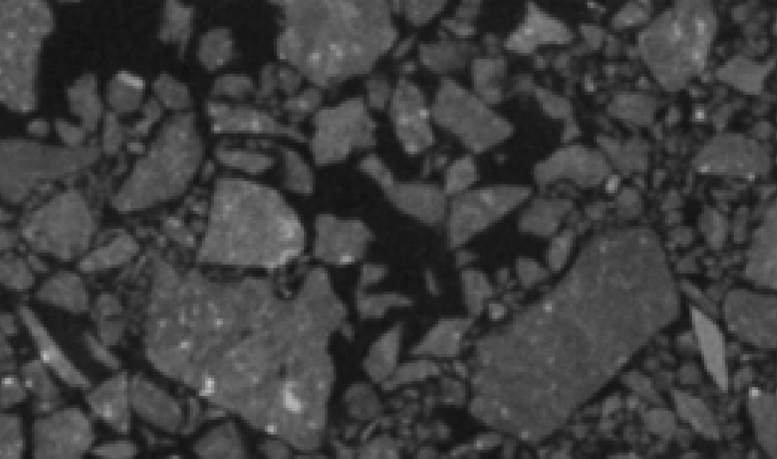
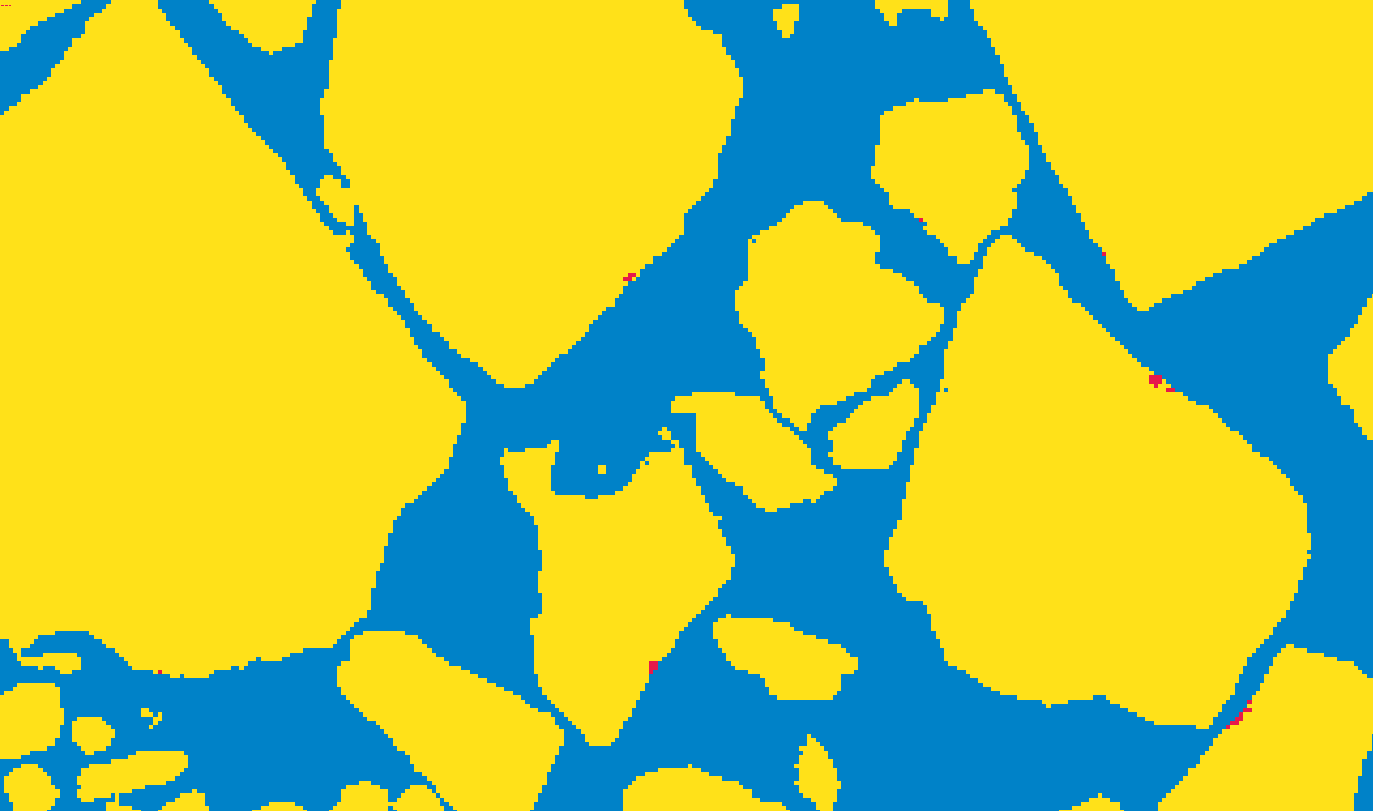
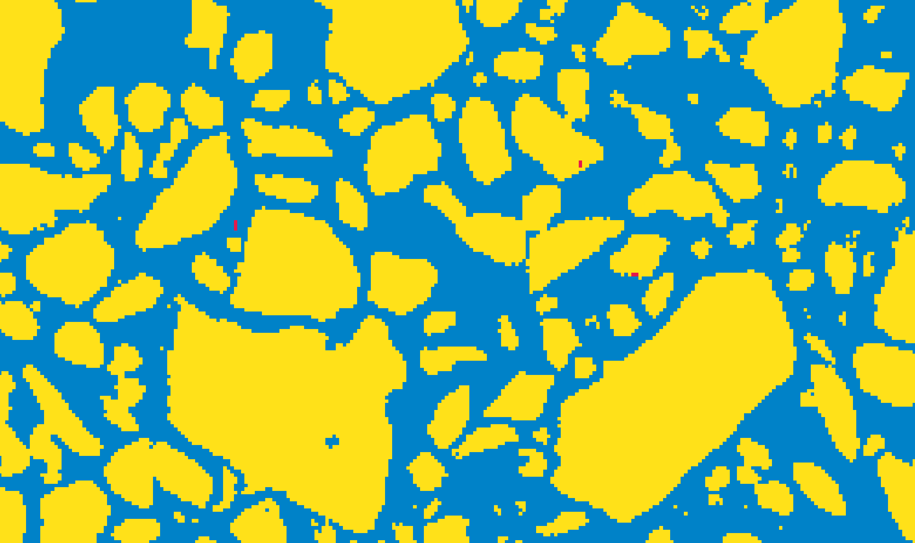
Actual Sample vs Grain Mask
Image credits: Dr. Scott Eckley, NASA Johnson Space Center

